Slide 1
Resource Manager (the critical piece of the consolidation puzzle) Karl Arao Accenture Enkitec Group

Slide 2
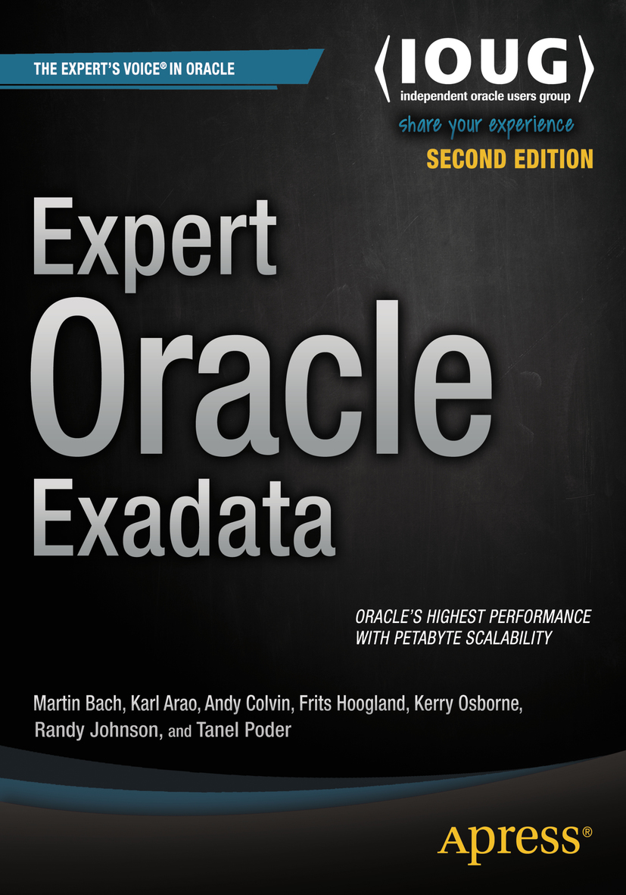




whoami
Karl Arao
Senior Principal Consultant @ Accenture Enkitec Group
Performance, Resource Management, Capacity Planning, Consolidation and Sizing
Prior to AEG - Solutions Architect and an R&D guy
9+ years database consulting experience
Oracle ACE, OCP-DBA, RHCE, OakTable
Blog: karlarao.wordpress.com
Wiki: karlarao.tiddlyspot.com
Twitter: @karlarao
Github: github.com/karlarao
Co-author: Expert Oracle Exadata 2nd Ed

Slide 3

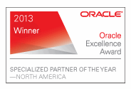

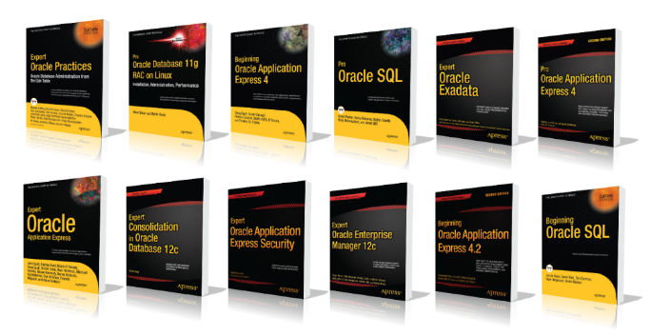
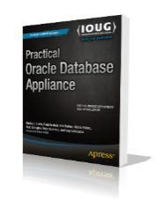
Accenture Enkitec Group
Global systems integrator focused on the Oracle platform
Consultants average 15+ years of Oracle experience
Worldwide leader in Exadata implementations
15+ Oracle ACE members
Innovation Center
Elite
Oracle Specializations
Oracle Exadata
Oracle Database
Oracle GoldenGate
Oracle Data Integrator
Oracle Data Warehouse
Oracle Real Application Cluster
Oracle Performance Tuning
Oracle Database Security
Expertise
Success
Our consultants have been published in multiple subject areas and additional online resources that demonstrate Accenture’s experience and expertise with the OES platform
Thought Leadership
Notes:
I work for a company called Accenture Enkitec Group.
Enkitec has been part of Accenture for about a year now.. So yes we became a subgroup inside Accenture
>We now have a global presence and we do anything that’s Oracle database related
>And we still have our innovation lab where we host our engineered systems for POCs, demos, and to play around with
>These are some of our specializations
>We are a diamond partner
>And here are some of the books we have written

Slide 4
Agenda
The Consolidation, Capacity, & Resource Management Lifecycle
DBRM/IORM new features and concepts
Barriers to adoption of RM
A systematic approach to RM
Real world scenario
Write intensive OLTP w/ some batch
Notes:
This is our agenda.
The Consolidation, Capacity, & Resource Management Lifecycle
> discuss how this all tie together
DBRM new features and concepts
> discuss some of the 12c features and show you the matrix of component level RM features (CPU, mem, IO)
Barriers to adoption of RM
> briefly discuss what I usually see in the field
A systematic approach to RM
> I'll show you how you can systematically approach RM
> from defining your perf obj., workload charac, up to defining the resource allocations, and implementing it
Example-based and problem/solution approach (some real world cases)
> Write intensive OLTP w/ some reports running at the same time

Slide 5
Let’s start w/ some illustrations…

Slide 6

photo credit: http://bit.ly/1US0gL3
Notes:
So here are the two of the cutest puppies contending for resource
>Later on at the last section of the PPT there will be an example showing this behavior
>1 CG w/ all app users tied to it
>And just by separating them to their individual CGs the overall experience got better

Slide 7

photo credit: http://bit.ly/1US0bXO

Slide 8
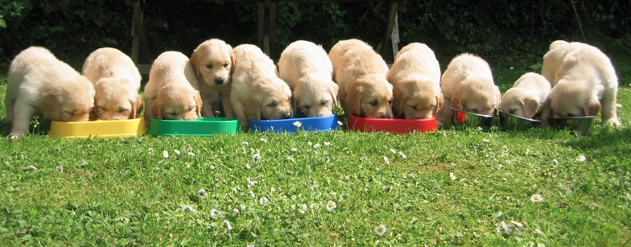
photo credit: http://bit.ly/1US0iCO
Notes:
And the concept is pretty much the same at scale..
But the overall idea here is if there’s “queueing” or “bottleneck” RM can be applied to provide a better overall experience for the more critical users

Slide 9
Capacity,
Consolidation, and Resource Management

Slide 10

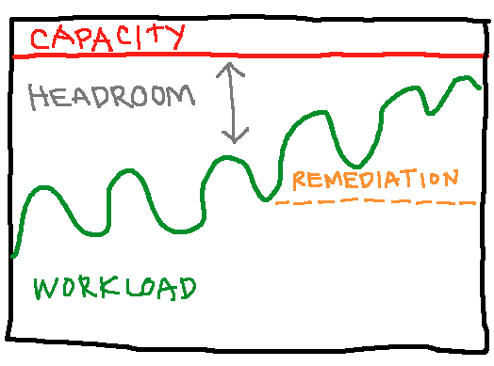



Capacity, Consolidation, & Resource Management
Priority
Criticality
Workload Type
Notes:
>Ultimately when we say RM, we apply the grouping of users by their Priority, Criticality, Workload type
>But then, it's not just entirely RM in the picture there are a couple of variables and RM is applied to the lifecycle of these variables
>here’s the complete picture
>so let’s backup a little bit and explain how they all tie together
>the primary driver of consolidation is cost savings that is to achieve greater efficiencies by improving the total resource utilization, basically making the environment more dense
But then your platform >can only do this much >And you would have this load
>As you increase the “trx” or “data” or “users” the load will grow overtime
>and if it reaches the capacity then you no longer have the headroom
>so tuning SQLs & finding the bottleneck will help you gain that headroom..
But then you reach this area .. That’s when you Max out or contend for resources
>so this is where the RM comes into play where we group the users/apps and let the highest priority users queue the least because even when the system is under heavy load the RM can still provide stability on the response times for critical users
> And the concept is pretty much the same at scale..

Slide 11
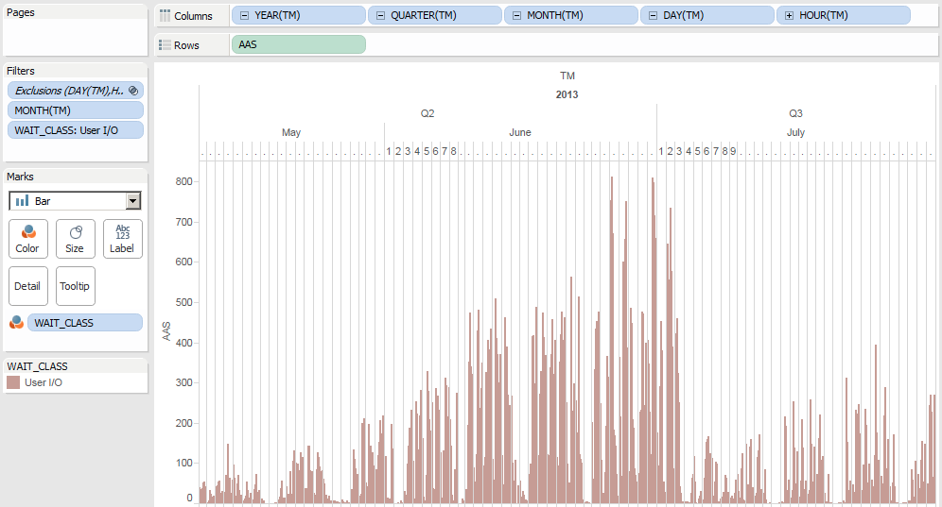
The workload
Notes:
So this is an example workload..
>What happened here is they just maxed out their capacity
>and there’s a big drop, and they are fine again
>So this is actually a quarter end process.. Intensive OLTP w/ big DW SQLs
>problem here is they don’t have much partitioning or purging policy
>as you can see as the data grow the AAS just keeps on increasing
>and they reached the max capacity of the platform, they were forced to purge the data. And that’s the drop
>because at peak point the OLTP sessions are just on hang and they can’t anymore process & have to do things sequentially
>when we did the purge we know we are fine but then if we are not going to do anything the workload will grow again and we will have to purge again
>at this point we had a couple of action items
>Lifecycle on purging, partitioning, compression, beef up our monitoring
>RM was critical during remediation because it kept everything under control

Slide 12
12c DBRM and IORM
Notes:
Before we move on to the real world scenario and systematic approach I’d like to give you some concepts and foundations

Slide 13
12c DBRM architecture
Non - multitenant
Plan
Directives
Consumer Groups
Multitenant
CDB
1..n
CDB
Plan
Directives
Default
(shares)
PDB 1..n
PDB
Plan
Directives
Consumer Groups
OTHER_GROUPS
Notes:
Here I’ll show you how percentage allocation of resources goes from one component of RM architecture to another

Slide 14
Non - multitenant
day_plan
batch_plan
Consumer Group | SHARES | Guaranteed CPU
APPS | 6 | 60.0%
REPORTS | 2 | 20.0%
MAINT | 1 | 10.0%
OTHERS | 1 | 10.0%
Consumer Group | SHARES | Guaranteed CPU
APPS | 2 | 20.0%
REPORTS | 6 | 60.0%
MAINT | 1 | 10.0%
OTHERS | 1 | 10.0%

Slide 15
Multitenant
CDB1 database – CDB Plan
PDB1 – PDB Plan
PDB1 – End Pct% Allocation
PDB | SHARES | Guaranteed CPU
PDB1 | 1 | 50.0%
PDB2 | 1 | 50.0%
Consumer Group | SHARES | Guaranteed CPU
APPS | 6 | 60.0%
REPORTS | 2 | 20.0%
MAINT | 1 | 10.0%
OTHERS | 1 | 10.0%
Consumer Group | SHARES | Guaranteed CPU
APPS | 6 | 30.0%
REPORTS | 2 | 10.0%
MAINT | 1 | 5.0%
OTHERS | 1 | 5.0%
PDB2 – PDB Plan
PDB2 – End Pct% Allocation
Consumer Group | SHARES | Guaranteed CPU
APPS | 6 | 60.0%
REPORTS | 2 | 20.0%
MAINT | 1 | 10.0%
OTHERS | 1 | 10.0%
Consumer Group | SHARES | Guaranteed CPU
APPS | 6 | 30.0%
REPORTS | 2 | 10.0%
MAINT | 1 | 5.0%
OTHERS | 1 | 5.0%
100%
Notes:
That’s how the flow of resource allocation works

Slide 16
RM matrix
Resource | 11gR2 | 12c
CPU | Instance Caging | cgroups/PROCESSOR_GROUP_NAME
 |  | THREADED_EXECUTION
Memory |  | PGA_AGGREGATE_LIMIT
IO | IORM (inter-database) | IORM (CDB+PDB)
 | IORM objective | IORM Profiles (DBaaS)
 |  | IORM for Flash (min & limit)
Notes:
shows you the component level RM features of 12c

Slide 17
Instance Caging
alter system set cpu_count = 4;
alter system set resource_manager_plan = 'default_plan';
32
16
1
8
8
4
8
4
4
8
4
Partitioning
Over-provisioning
Notes:
Pretty simple
If you have 16CPUs and 4 databases what you can do is Partition or Over-provision

Slide 18
cgroups and PROCESSOR_GROUP_NAME
Using PROCESSOR_GROUP_NAME to bind a database instance to CPUs or NUMA nodes on Linux” (Doc ID 1585184.1)
# ./setup_processor_group.sh -show
# ./setup_processor_group.sh -prepare
# ./setup_processor_group.sh -check
# ./setup_processor_group.sh -create -name limitedcpu -cpus 0,1 -u:g oracle:dba
alter system set processor_group_name='limitedcpu' scope=spfile;
shutdown immediate
startup
NOTE: CDB level only, PDB inherits the settings
top - 01:28:21 up 8:46, 3 users, load average: 2.54, 1.66, 0.80
Tasks: 203 total, 5 running, 198 sleeping, 0 stopped, 0 zombie
Cpu0 : 96.2%us, 2.4%sy, 0.0%ni, 1.0%id, 0.0%wa, 0.0%hi, 0.3%si, 0.0%st
Cpu1 : 98.6%us, 0.7%sy, 0.0%ni, 0.7%id, 0.0%wa, 0.0%hi, 0.0%si, 0.0%st
Cpu2 : 1.9%us, 1.1%sy, 0.0%ni, 97.0%id, 0.0%wa, 0.0%hi, 0.0%si, 0.0%st
Cpu3 : 0.3%us, 0.7%sy, 0.0%ni, 99.0%id, 0.0%wa, 0.0%hi, 0.0%si, 0.0%st
Mem: 1018228k total, 942236k used, 75992k free, 3224k buffers
Swap: 1257468k total, 382052k used, 875416k free, 579964k cached
PID USER PR NI VIRT RES SHR S %CPU %MEM TIME+ COMMAND
8863 oracle 20 0 705m 58m 55m S 48.0 5.9 1:56.25 oracleorcl (LOCAL=NO)
8865 oracle 20 0 705m 56m 53m R 46.7 5.7 1:56.28 oracleorcl (LOCAL=NO)
8861 oracle 20 0 705m 48m 45m R 46.0 4.9 1:56.48 oracleorcl (LOCAL=NO)
8857 oracle 20 0 705m 53m 50m R 45.7 5.4 1:56.20 oracleorcl (LOCAL=NO)
Notes:
OEL 5 w/ UEK2 (2.6.24) or OEL6
11.2.0.4
>the database integrates w/ the cgroups feature w/ the PROCESSOR_GROUP_NAME parameter

Slide 19
cgroups and PROCESSOR_GROUP_NAME
32
16
1
8
A
B
8
A
4
8
16
C
Paying Customers
B
4
C
4
E - Z
8
E - Z
Non-paying Customers
D
D
4
2
2
2
Partitioning
Over-provisioning
cgroups

Slide 20
THREADED_EXECUTION
conn / as sysdba
alter system set threaded_execution=true scope=spfile;
configure listener parameter dedicated_through_broker_<listener_name>=on
shutdown immediate
conn sys/<password> as sysdba
startup
-- before
$ ps -eLf | grep noncdb | wc -l
221
oracle@enkdb03.enkitec.com:/home/oracle:noncdb1
$ ps -ef | grep noncdb | wc -l
221
-- after
oracle@enkdb03.enkitec.com:/home/oracle:noncdb1
$ ps -eLf | grep noncdb | wc -l
229
oracle@enkx4db01.enkitec.com:/home/oracle:noncdb1
$ ps -ef | grep noncdb | wc -l
19
Notes:
>database processes as threads hence threaded execution
>the overall number of processes is reduced

Slide 21
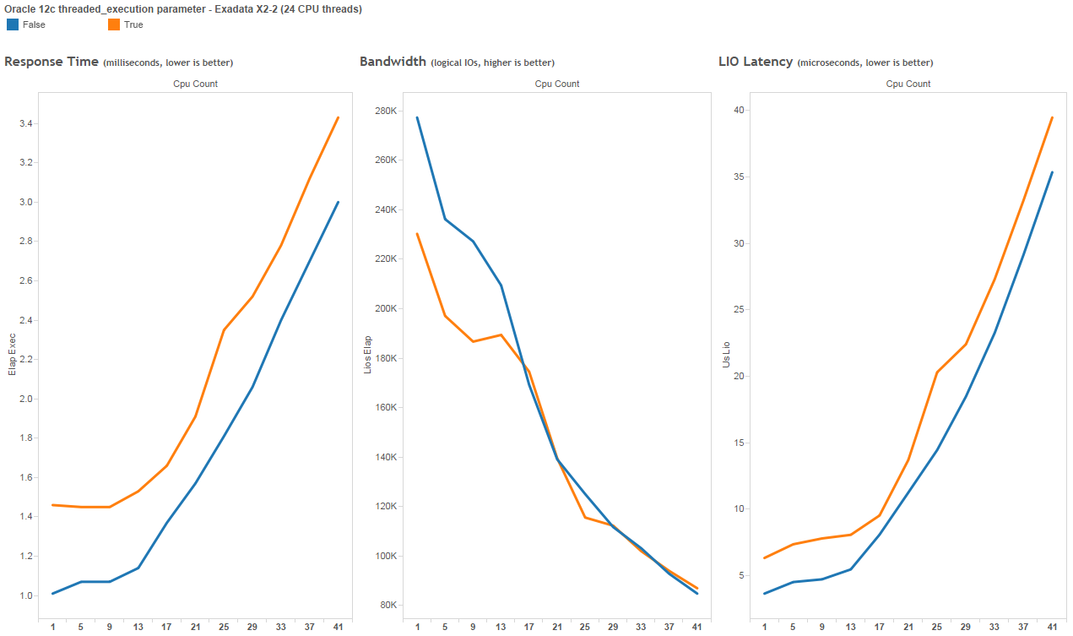
THREADED_EXECUTION

Slide 22
RM matrix
Resource | 11gR2 | 12c
CPU | Instance Caging | cgroups/PROCESSOR_GROUP_NAME
 |  | THREADED_EXECUTION
Memory |  | PGA_AGGREGATE_LIMIT
IO | IORM (inter-database) | IORM (CDB+PDB)
 | IORM objective | IORM Profiles (DBaaS)
 |  | IORM for Flash (min & limit)

Slide 23
PGA_AGGREGATE_LIMIT
PGA_AGGREGATE_LIMIT (instance wide hard limit, terminates processes)
greatest (2GB, 200% of PGA_AGGREGATE_TARGET, 3MB x PROCESSES parameter)
Automatically enabled but if a value of 0 is specified, it means there is no limit to the aggregate PGA memory consumed by the instance
TS@v12102 > @pga_filler
error message :ORA-04036: PGA memory used by the instance exceeds PGA_AGGREGATE_LIMIT
start pga :3338760
last pga :807924232 or 770.5MB
pga agg target:524288000 or 500MB
pga agg limit :629145600 or 600MB
PL/SQL procedure successfully completed.
Before 12c here’s how we limit the PGA usage:
event 10261.. level <MEM in KB> (per process limit, terminates process, outputs ORA- error)
_PGA_MAX_SIZE, _SMM_MAX_SIZE (per process workarea size, does not terminate process, but you'll run slower)

Slide 24
PGA_AGGREGATE_LIMIT
Only applicable to CDB, PDB inherits the value
SYS@pdb1> alter system set pga_aggregate_limit=4G;
alter system set pga_aggregate_limit=4G
*
ERROR at line 1:
ORA-65040: operation not allowed from within a pluggable database
select name from v$parameter where ISPDB_MODIFIABLE=‘TRUE’;
Monitor your workload PGA usage and adjust accordingly
dba_hist_pgastat (total PGA allocated)
More details @ https://fritshoogland.wordpress.com/tag/pga_aggregate_limit/

Slide 25
RM matrix
Resource | 11gR2 | 12c
CPU | Instance Caging | cgroups/PROCESSOR_GROUP_NAME
 |  | THREADED_EXECUTION
Memory |  | PGA_AGGREGATE_LIMIT
IO | IORM (inter-database) | IORM (CDB+PDB)
 | IORM objective | IORM Profiles (DBaaS)
 |  | IORM for Flash (min & limit)

Slide 26
IORM architecture
Objective | Category | Profiles | Inter-DB | CDB | DBRM (intra-DB) | USER/APP
basic |  | gold | cdb1
high throughput |  |  |  | pdb1
balanced | batch |  |  |  | dw_critical | oracle
low_latency | batch |  |  |  | dw_adhoc | oracle2
auto | apps |  |  |  | oltp | slob
 |  |  |  | pdb2
 | batch |  |  |  | dw_critical | oracle
 | batch |  |  |  | dw_adhoc | oracle2
 | apps |  |  |  | oltp | slob
 |  |  |  | pdb3
 | batch |  |  |  | dw_critical | oracle
 | batch |  |  |  | dw_adhoc | oracle2
 | apps |  |  |  | oltp | slob
 |  | silver | cdb2
 |  |  |  | pdb4
 | batch |  |  |  | dw_critical | oracle
 | batch |  |  |  | dw_adhoc | oracle2
 | apps |  |  |  | oltp | slob
 |  | bronze | noncdb
 | batch |  |  |  | dw_critical | oracle
 | batch |  |  |  | dw_adhoc | oracle2
 | apps |  |  |  | oltp | slob
 |  | DEFAULT | OTHER (demo)
 | batch |  | or DEFAULT |  | dw_critical | oracle
 | batch |  |  |  | dw_adhoc | oracle2
 | apps |  |  |  | oltp | slob

Slide 27
IORM, CDB, PDB, CG
IORM Profiles |  |  |  |  | CDB1 database - CDB Plan |  |  |  | pdb1 - Intradatabase Plan |  |  |  | End Pct% Allocation
Database Name | PROFILE | SHARES | Guaranteed IO |  | PDB | SHARES | Gueranteed CPU/IO |  | Consumer Group | SHARES | Guaranteed CPU/IO |  | Consumer Group or DB | End Pct% Allocation
CDB1 | GOLD | 5 | 62.5% |  | pdb1 | 1 | 50.0% |  | APPS | 6 | 60.0% |  | pdb1 - APPS | 18.8%
NONCDB | BRONZE | 2 | 25.0% |  | pdb2 | 1 | 50.0% |  | REPORTS | 2 | 20.0% |  | pdb1 - REPORTS | 6.3%
DEMO | (DEFAULT) | 1 | 12.5% |  |  |  |  |  | MAINT | 1 | 10.0% |  | pdb1 - MAINT | 3.1%
 |  |  |  |  |  |  |  |  | OTHERS | 1 | 10.0% |  | pdb1 - OTHERS | 3.1%
 |  |  |  |  |  |  |  |  | pdb2 - Intradatabase Plan |  |  |  | pdb2 - APPS | 18.8%
 |  |  |  |  |  |  |  |  | Consumer Group | SHARES | Guaranteed CPU/IO |  | pdb2 - REPORTS | 6.3%
 |  |  |  |  |  |  |  |  | APPS | 6 | 60.0% |  | pdb2 - MAINT | 3.1%
 |  |  |  |  |  |  |  |  | REPORTS | 2 | 20.0% |  | pdb2 - OTHERS | 3.1%
 |  |  |  |  |  |  |  |  | MAINT | 1 | 10.0%
 |  |  |  |  |  |  |  |  | OTHERS | 1 | 10.0% |  | NONCDB | 25.0%
 |  |  |  |  |  |  |  |  |  |  |  |  | DEMO | 12.5%
 |  |  |  |  |  |  |  |  |  |  |  |  | TOTAL | 100.0%
Notes:
Let’s see how the flow of resource allocation works

Slide 28
IORM directives matrix
 | level | allocation | shares | limit ₁ | role ₂ | flashcache | flashlog | flashcachemin | flashcachelimit | type | DEFAULT | OTHER | PDB
Category | yes ₁₀ | yes ₁₀ | no | no | no | no | no | no | no | no | no | yes | no
Profiles | no | no | yes ₁₀ | yes ₁₀ | no | yes | yes | yes | yes | yes | yes | no | yes ₁₂
Inter-DB | yes | yes | yes | yes | yes | yes | yes | yes | yes | yes ₃ | yes ₃ | yes ₄ | no
CDB | no | no | yes | yes ₅ | no | no | no | no | no | no | yes ₆ | no | yes
Intra-DB ₁₁ | yes ₇ | yes ₈ | yes | yes ₅ | no | no | no | no | no | no | no | yes ₉ | no
[1] | LIMIT can be used by SHARES or LEVEL and ALLOCATION
[2] | should have both primary and standby directives set
[3] | only if using shares
[4] | only if using level and allocation
[5] | UTILIZATION_LIMIT and PARALLEL_SERVER_LIMIT directives
[6] | DEFAULT shares setting for new PDBs
[7] | the easiest way is to go with SHARES
 | or go with RATIO (set on DBMS_RESOURCE_MANAGER.CREATE_PLAN) and treat the numbers as SHARES on the MGMT_P1
 | or go with EMPHASIS (default on DBMS_RESOURCE_MANAGER.CREATE_PLAN) and be within 100% on the MGMT_P1
[8] | specified on MGMT_P1
[9] | OTHER_GROUPS is required
[10] | Category Plan can't be used when IORM Profiles is used (vice versa)
[11] | Applies to DBRM and PDB
[12] | db_performance_profile must be set on either non-CDB or CDB (all PDBs inherit the settings of CDB$ROOT)

Slide 29
Barriers to adoption of RM

Slide 30
Barriers to adoption of RM
1) Politics
I get more and you get less
They always consume more
Facts, numbers, figures
2) Fear
Things may go wrong after the change? or get worse?
Lack of knowledge
Research
Fearlessly change/experiment
Measure
Repeat

Slide 31
A systematic approach to RM

Slide 32
A systematic approach to RM
What is your performance objective?
Workload Characterization
Validate the load against capacity
Identify & group the apps/users causing resource hog
Implement RM
Execute remediation steps or add capacity
Notes:
Usually the app owners would have an idea which one is the priority or how these groups will work better together.
Because they would know more about the app SLAs than you

Slide 33
Sweet spot ☺
TRX
Reports
Pct. Allocation
Notes:
>this will all come down to assigning "pct allocations“
>it doesn't mean that they are going to run slower, you are actually guarenteeing their performance if the DBs contend for resources

Slide 34
A systematic approach to RM
What is your performance objective?
Workload Characterization
Validate the load against capacity
Identify & group the apps/users causing resource hog
Implement RM
Execute remediation steps or add capacity

Slide 35
Combined workload analysis
Individual database analysis
Logical breakdown (app) of workload
Workload windows, latency, response times
https://github.com/karlarao/run_awr-quickextract
https://github.com/carlos-sierra/edb360
https://github.com/carlos-sierra/esp_collect
Notes:
show the “Peoplesoft on Exadata.pptx” as a quick example of combined workload analysis

Slide 36
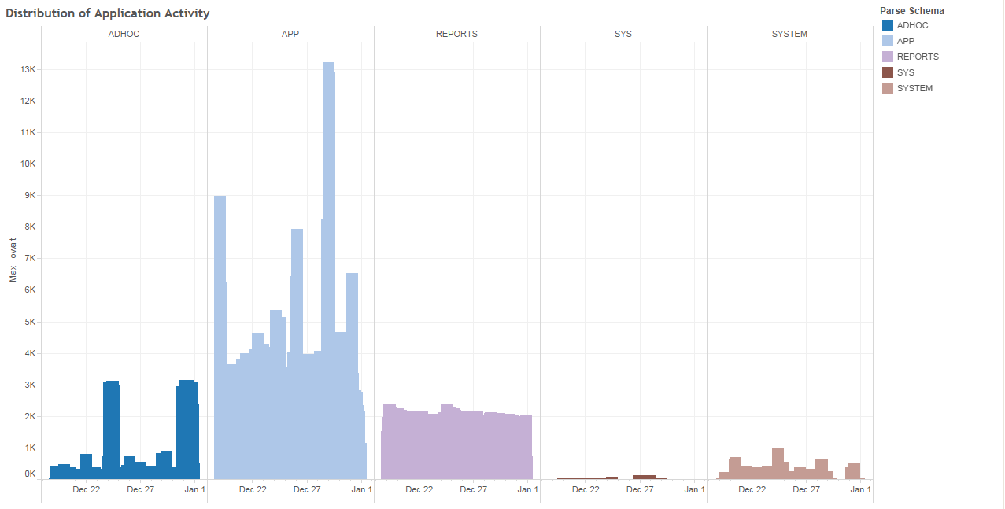
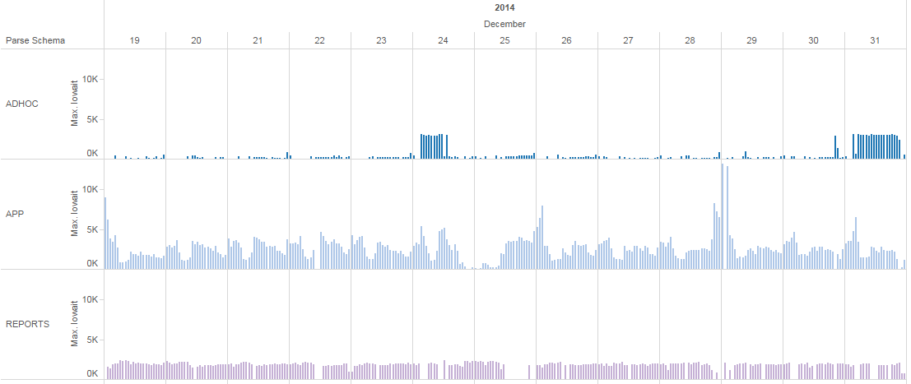
Source of app workload info:
dba_hist_sqlstat
ASH

Slide 37
A systematic approach to RM
What is your performance objective?
Workload Characterization
Validate the load against capacity
Identify & group the apps/users causing resource hog
Implement RM
Execute remediation steps or add capacity
Notes:
from here you can easily tell if it's a capacity issue, perf issue, or RM issue

Slide 38
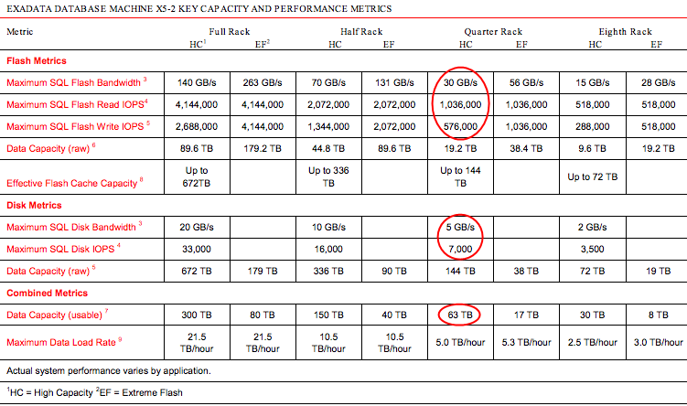

Slide 39
A systematic approach to RM
What is your performance objective?
Workload Characterization
Validate the load against capacity
Identify & group the apps/users causing resource hog
Implement RM
Execute remediation steps or add capacity

Slide 40
A systematic approach to RM
What is your performance objective?
Workload Characterization
Validate the load against capacity
Identify & group the apps/users causing resource hog
Implement RM
Execute remediation steps or add capacity
Notes:
>create consumer groups, directives, plan - work with the developers and app team!

Slide 41
A systematic approach to RM
What is your performance objective?
Workload Characterization
Validate the load against capacity
Identify & group the apps/users causing resource hog
Implement RM
Execute remediation steps or add capacity
Notes:
>once everything is stable and under control. execute the remediation steps

Slide 42
Real World Scenario:
Write intensive OLTP w/ some batch

Slide 43
The workload

Slide 44
Problems:
Saturated IO subsystem
Mixed IO workload (OLTP/DW)
Ineffective Resource Management
Ineffective Workload Distribution
Incomplete Partitioning/Purging Strategy
Ineffective Compression Strategy
Application issues
Fix:
Alter the resource plan
Evenly distribute the workload
Alter IORM objective
Remediation steps
SQL tuning
Drop unnecessary Indexes
Partitioning and Compression
Purging

Slide 45
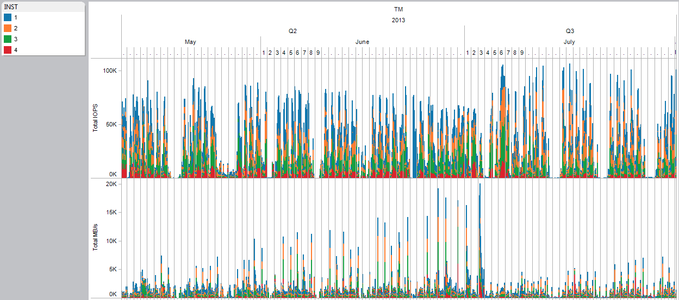
Saturated IO

Slide 46
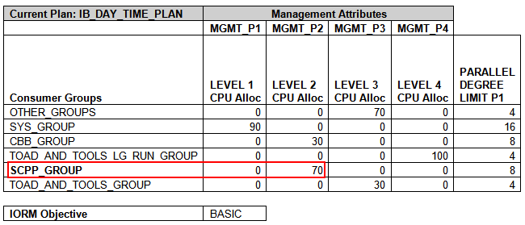
Old RM Plan

Slide 47
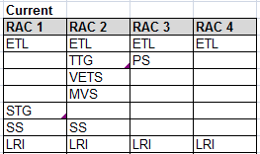
Old Workload distribution

Slide 48
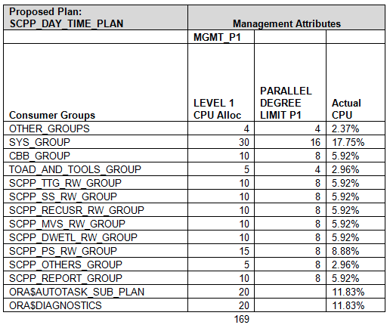
New RM Plan

Slide 49
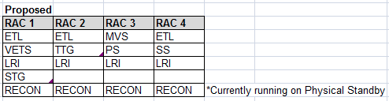
New Workload Distribution

Slide 50
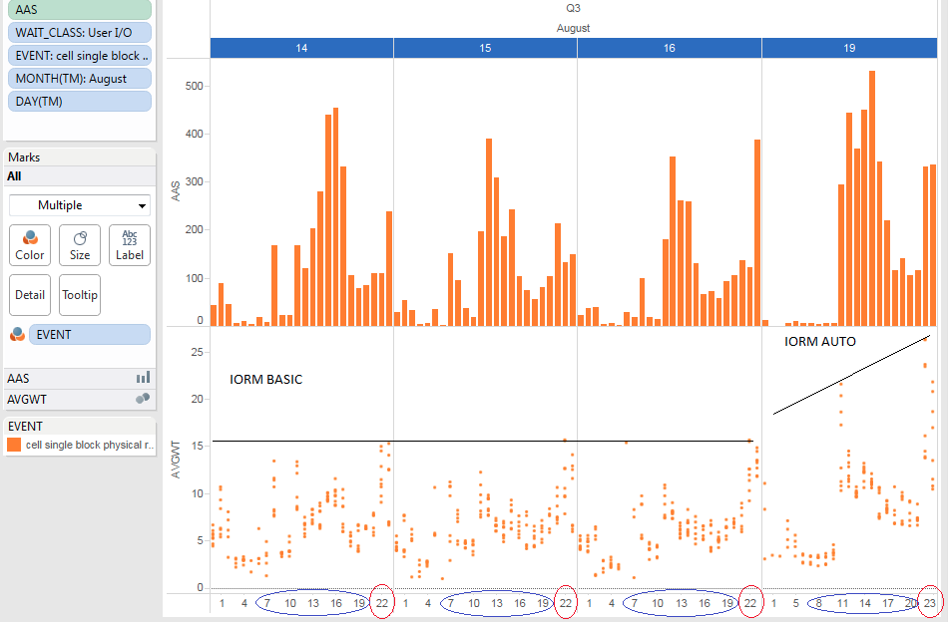
Change IORM objective

Slide 51
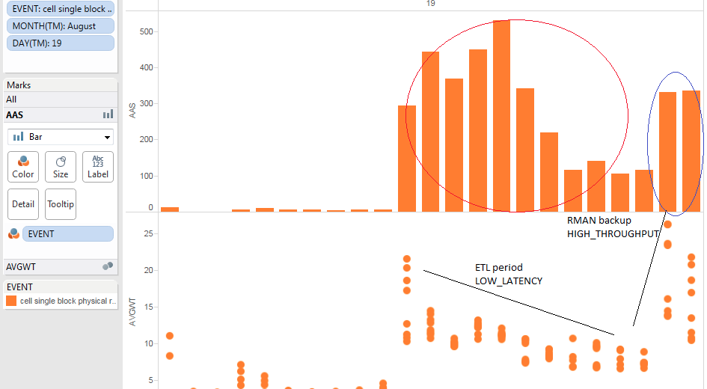

Slide 52
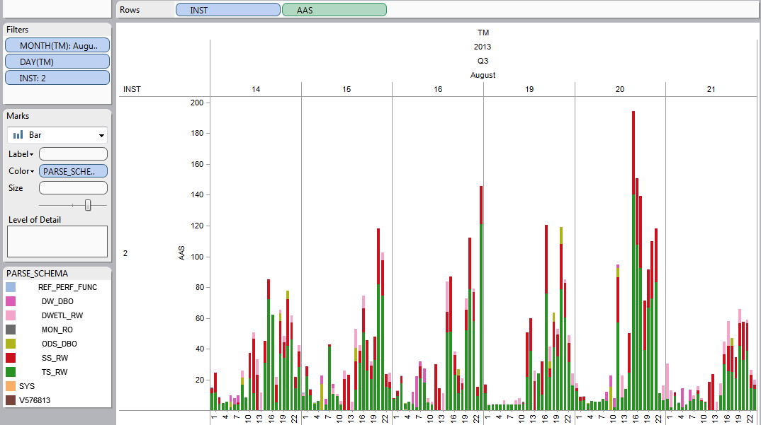
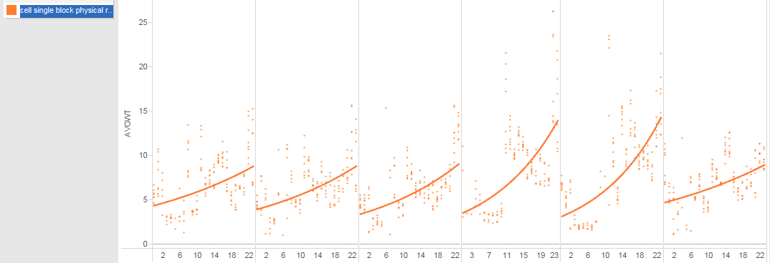
IORM BASIC
IORM AUTO
IORM
LOW
LATENCY

Slide 53
Questions?
@karlarao
karl.arao@enkitec.com

Slide 54
References & Scripts
References:
Expert Oracle Exadata 2nd Ed http://www.apress.com/9781430262411
Oracle Multitenant http://www.oracle.com/technetwork/database/multitenant-wp-12c-1949736.pdf
MOS note: Considerations about multi level resource plan (Doc ID 1590299.1)
MOS note: Using PROCESSOR_GROUP_NAME to bind a database instance to CPUs or NUMA nodes on Linux” (Doc ID 1585184.1)
notes: cgroups - overallocation, guarantee http://bit.ly/1s6vWyD
notes: 12c threaded_execution http://bit.ly/1ICenzu
notes: pga_aggregate_limit http://bit.ly/1R1pciL
notes: ResourceManager http://bit.ly/1VdYfJh
notes: HOWTO: Resource Manager and IORM by Cluster Service http://bit.ly/1OMbYZW
notes: ADG (Active Data Guard) RM config on SAP http://bit.ly/1tTxPoA
notes: RM shares commands - prior 12c http://bit.ly/1OMccQS
notes: resource manager - shares vs percentage, mgmt_mth http://bit.ly/1VdY5S6
notes: resource manager - multi level plans , mgmt_p1 http://bit.ly/1Ve0f4k
notes: resource manager - FORCE plan behavior http://bit.ly/1VdZ7h4
notes: resmgr:cpu quantum - preemtion http://bit.ly/1VdYC6y
MOS note: Configuring Exadata I/O Resource Manager for Common Scenarios (Doc ID 1363188.1)
“Resource Manager – 12c” by Sue Lee http://bit.ly/1izvRou
“Resource Manager – Common Mistakes” by Sue Lee http://bit.ly/1iPd8Gp
Scripts:
https://github.com/karlarao/run_awr-quickextract
https://github.com/carlos-sierra/edb360
https://github.com/carlos-sierra/esp_collect

